Slide 1

MENTAL HEALTH DETECTION USING ANN AND FUZZY LOGIC
Soft computing cse2009
Guided by :
DR A.Shanthi

Slide 2

Agenda
Introduction
Literature survey
Problem statement
Objectives
Block diagram
Base paper
Advantages
Disadvantages
Conclusion
References

Slide 3
INTRODUCTION
1 | A person's mental well-being is his or her mental condition, as well as an overview of his or her general environment. Brain chemistry abnormalities are the cause of mental illness.
2 | An individual's mental health serves as a barometer for properly addressing his or her diseases
3 | To predict any health-related irregularities, it is critical to keep track of diverse groups' mental health profiles.
4 | The community is made up of working professionals, college students, and high school students.
6 | You can also record a video inside the editor! Go to 'Uploads' and click on 'Record yourself'.

Slide 4
Literature Survey
Title | Methodology | Advantages | Drawbacks
Application of Machine Learning Methods in Mental Health Detection: A Systematic Review Rohizah Abd Rahman Khairuddin Omar; Shahrul Azman Mohd Noah; | This paper presents a critical assessment of mental health detection in online social networks, focusing on data sources and machine learning techniques. | Provides a comprehensive overview of existing methods and identifies potential areas for improvement. | May not offer new empirical data or novel methodologies.
Mental Health State Detection Using OpenCV and Sentiment Analysis Manav Pradeep Jain, Soumyaprakash Sribash Dasmohapatra, Stevina Correia | The system predicts an individual's mental health state using OpenCV for facial recognition and sentiment analysis techniques. | Combines visual and textual data for a more holistic assessment. | Requires access to both facial images and textual data, which may not always be available.

Slide 5
Literature Survey
Title | Methodology | Advantages | Drawbacks
Machine Learning Models Based Mental Health Detection Rani Pacharane, K. Mishra, S.K. Thripathi, M. Kanojia | This study employs machine learning algorithms to screen mental health using a Mental Disorder Questionnaire (MDQ). | Automates mental health assessment, potentially increasing efficiency and accessibility. | The accuracy of the assessment depends on the quality and honesty of questionnaire responses.
Detection and Prediction of Future Mental Disorder from Social Media Data Mohammed Abdullah,Nermin Negid | This study deploys nineteen different models to detect and predict mental disorders from social media data | Utilizes real-time data from social media, allowing for timely detection and intervention. | Privacy concerns and the potential for misinterpretation of social media content.

Slide 6
Problem statement
The Mental Health Issue theory contends that issues start in childhood and continue through adolescence and adulthood.
There is a critical need for an effective, scalable, and non-intrusive method to detect early signs of mental health issues. Current approaches lack the ability to analyze large volumes of unstructured data from social media in real-time, leading to missed opportunities for early intervention. Additionally, existing models often fail to account for the complexity and variability of human emotions, which can result in inaccurate predictions and potential harm.
This study, motivated by the growing use of machine learning techniques in the research aspects of medical diagnosis,aims to examine the possible application of several algorithms for predicting and analyzing Mental Health Issue difficulties in kids, teens, and adults.

Slide 7
Objectives
Data Collection and Preprocessing: Collect relevant data from various sources, such as surveys, social media, or wearable devices.
Feature Selection and Extraction: Use techniques like Principal Component Analysis (PCA) or feature importance from machine learning models to reduce dimensionality.
Model Development: Develop and implement various soft computing models (e.g., neural networks, support vector machines, decision trees) to classify mental health conditions.
Real-time Detection: Implement a system for real-time detection of mental health issues based on user input or continuous data streams.
User Interface Development: Ensure the interface is user-friendly and accessible to a diverse audience.
User Feedback and Iteration: Gather feedback from users and mental health professionals to improve the system.
Awareness and Education: Develop educational materials to raise awareness about mental health issues and the importance of early detection.

Slide 8
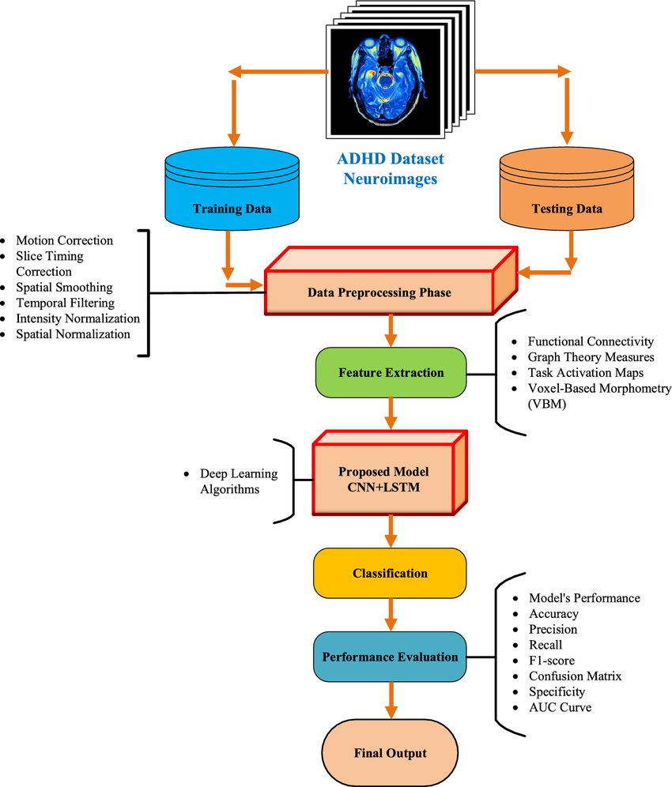
Block
Diagram

Slide 9
Base paper
This study investigates the application of machine learning algorithms in predicting mental health outcomes without the need for invasive procedures. The research explores various algorithms and evaluates their accuracy in forecasting mental health conditions. The findings indicate that machine learning algorithms can predict mental health outcomes with high accuracy, and that adding demographic, behavioral, and other relevant data can enhance the predictive performance. The study emphasizes the potential of machine learning in early detection and intervention for mental health issues.
link
cliick here

Slide 10
Advantages
Soft computing techniques, such as fuzzy logic and neural networks, can handle uncertainty and imprecision, making them suitable for the complex nature of mental health data.
Machine learning algorithms can analyze large datasets to identify patterns and correlations that may not be evident through traditional statistical methods, leading to more accurate predictions of mental health issues.
Many soft computing systems can process data in real-time, allowing for timely interventions and support for individuals at risk of mental health crises.
Soft computing can facilitate personalized mental health care by analyzing individual data and tailoring interventions based on specific needs and conditions.
These techniques can integrate various data types (e.g., text, audio, video) to provide a comprehensive view of an individual's mental health, enhancing the understanding of their condition.
Soft computing models can be scaled to analyze large populations, making them useful for public health initiatives and research.

Slide 11
Disadvantages
The collection and analysis of sensitive mental health data raise significant privacy and ethical concerns, particularly regarding consent and data security.
Many soft computing models, especially deep learning algorithms, are often seen as "black boxes," making it difficult for practitioners to interpret the results and understand the decision-making process.
The effectiveness of soft computing techniques relies heavily on the quality and quantity of data. Poor or biased data can lead to inaccurate predictions and reinforce existing disparities.
There is a risk of overfitting models to training data, which can reduce their generalizability to new, unseen data, potentially leading to incorrect assessments.
Developing and deploying soft computing models can be resource-intensive, requiring significant computational power and expertise in data science and machine learning.
There is a risk that mental health predictions could be misused, leading to stigmatization or discrimination against individuals identified as at risk.

Slide 12
Conclusion
In this study, multiple machine learning and deep learning approaches were used to try and detect Mental Stress Detection
.
The effectiveness of the models employed for Mental illness identification on non-clinical datasets from three sets of age groups, namely children, adolescents, and adults, was examined using a variety of performance evaluation measures.
We believe we were able to achieve a good accuracy for each of the four diseases.
Furthermore, in future we can add more disease and combine multiple method along with questionnaire to make this process more robust and stronger.

Slide 13
References
Reference 1
Title: Machine Learning Models Based Mental Health Detection (2022)
Summary: This study employs machine learning algorithms to screen mental health using a Mental Disorder Questionnaire (MDQ). The system automates mental health assessment, potentially increasing efficiency and accessibility. However, its accuracy depends on the quality and honesty of responses.
Reference 2
Title: Detection and Prediction of Future Mental Disorder from Social Media Data (2023)
Summary: This study deploys nineteen different models to detect and predict mental disorders from social media data. It leverages real-time social media insights for timely detection but faces challenges related to privacy concerns and content misinterpretation.
Reference 3
Title: Application of Machine Learning Methods in Mental Health Detection: A Systematic Review (2020)
Summary: This paper provides a comprehensive review of mental health detection in online social networks, analyzing data sources and machine learning techniques. It highlights current research gaps but does not introduce new empirical data.
Reference 4
Title: Mental Health State Detection Using OpenCV and Sentiment Analysis (2021)
Summary: This study integrates OpenCV for facial recognition and sentiment analysis to predict an individual’s mental health state. While it provides a holistic assessment combining visual and textual data, it requires access to both, which may not always be feasible.
https://ieeexplore.ieee.org/document/9917622
https://ieeexplore.ieee.org/document/10540133
https://ieeexplore.ieee.org/document/9214815
https://ieeexplore.ieee.org/document/9315984

